Slide 1

Group 2:
Anna Nordlöv
Qu Wang
Rob de Groot

Slide 2
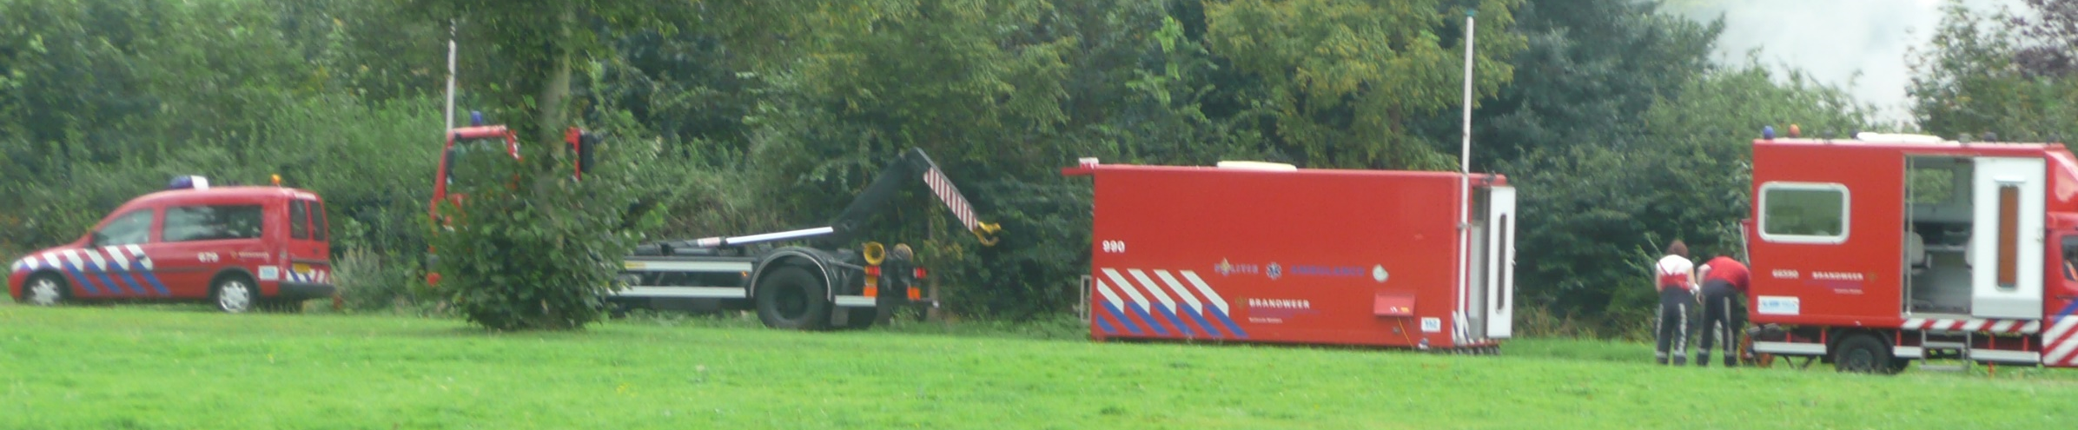
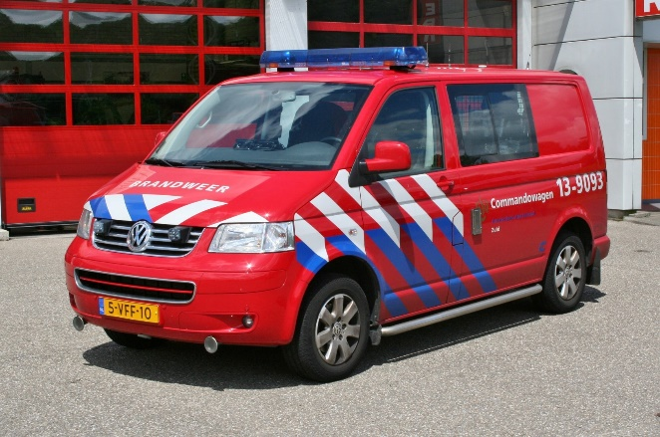
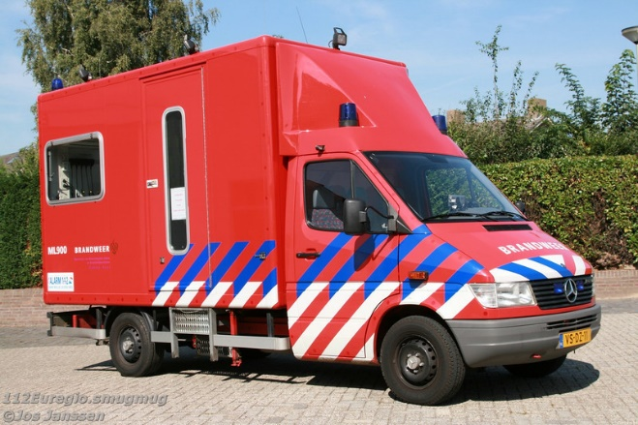
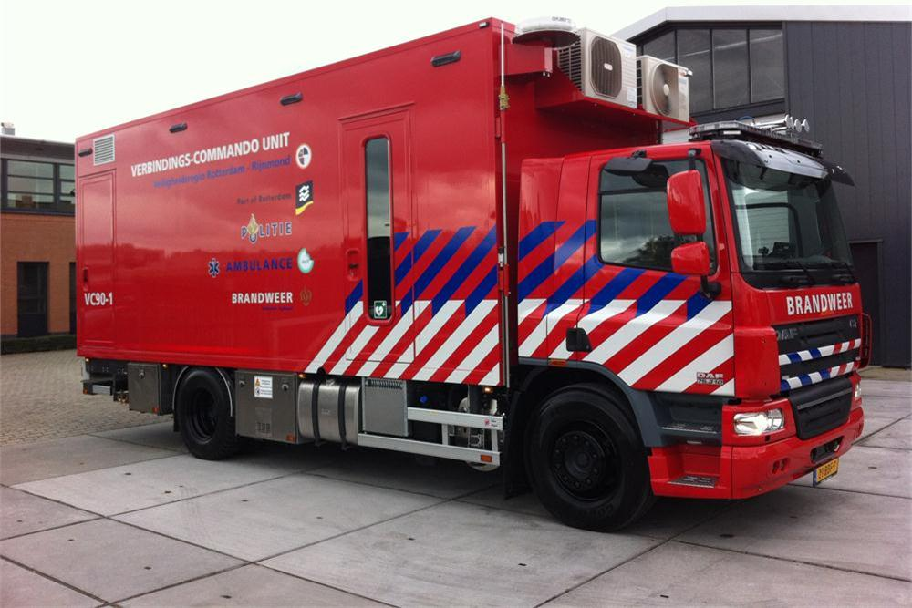
For who is it made?
Fire department
Commander (OvD)
VC-3/2/1 (Connection and commandvehicle)
Notes:
VC-1: Large truck (only in Waalre & Barendrecht) VC-2: Mercedes van VC-3: transporter. Container-thing: VC-2/3 + container = VC-1

Slide 3
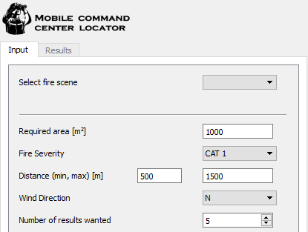
What does it do?
Supports decision on placing MCC by:
Providing suitable areas based on a set of parameters:
Notes:
In case of a fire, where a Mobile Command Center (MCC) is required, this tool supports the decision on where to place the MCC. It does this by providing a set of suitable areas to the commander, so he doesn’t have to think this through in a situation where time is of great importance.

